Slide 1



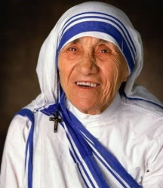

St John Vianney Catholic Primary
WEEKLY SCHOOL NEWSLETTER – Friday 11th September 2026
Dear Parents,
“It is by forgiving that one is forgiven.” St Teresa of Calcutta (Mother Teresa)
In this Sunday’s Gospel, Peter asks Jesus how many times we should forgive. Jesus’ answer shows us that we must forgive one another just as God forgives us: again and again, without limit.
God is our loving Father, and we can always count on His loving forgiveness and the freedom that His forgiveness brings. Jesus instructs us to be just as forgiving towards others.
Forgiveness is the lifeblood of any family or community. St John Paul II reminds us, “Forgiveness does not come naturally. Forgiving from the heart can sometimes be actually heroic.”
Giving or asking for forgiveness is a powerful way to build stronger relationships with others and with God. We can be certain that, no matter how many times we need to forgive or ask for forgiveness, God will always be there to help us.
Future Dates
21st Sept – Y6 Library Visit – 1.30 p.m.
23rd Sept – Y6 Reading Café – 8.45 a.m.
24th Sept – Bishop Ullathorne Open Evening 5-7.00 p.m.
25th Sept – Reception Welcome Assembly – 9.00 a.m.
Our Mission This Week
Saint of the week – St Teresa of Calcutta
WHO IS SHE?
St Teresa of Calcutta loved Jesus deeply and tried to see Him in every person she met, especially those who were poor, sick or forgotten. She founded the Missionaries of Charity, a community of nuns who cared for people who had nowhere else to go. Mother Teresa often remembered Jesus’ words from the Cross: “I thirst”, and she understood this as Jesus asking her to love Him by loving others. She once said, “If you can’t feed a hundred people, then feed just one,” reminding us that even a small act of love can make a difference.
This week’s mission: Help three people in need. In particular, try to notice those who others may have forgotten.
.
St John Vianney Catholic Primary School
Mount Nod Way
Coventry
CV5 7GX
Sjv_admin@hccmac.co.uk
Twitter: @sjohnvianney
Phone 02476 464088
Website: www.sjv.hccmac.co.uk

Slide 2



Congratulations to our Reception and Nursery pupils who started this week. They have made a great start, and there are already some lovely pictures on the wall.
Congratulations to Roisin who represented Great Britain in the world Karate Championships and gained a gold and silver medal. Massive well done.
Thank you to all the parents who turned out over the last few nights. We shared the expectations for each class and helped parents to understand the requirements of our school.
Our children make great progress at St John Vianney because we have a fabulous partnership with our parents. Together, we work to help your child make the best possible progress.
Please remember that, if you have a concern, we are available on the gates in the morning or on the playground at the end of the day.
We have already started the year with a whole school Mass, and we encourage you to attend Mass at the weekend as we celebrate Education Sunday.
Year 5 have started their first visits to the library. We are trying to foster a love of reading because a good reader becomes an excellent writer.
Please encourage your child to use the library and read stories to them at bedtime. This is a special memory that will stay with your child forever. My children are all grown up now, and they still talk about the books I used to read to them at bedtime.

Slide 3

As a staff, we have completed our safeguarding training, and the children are aware of who they can talk to if they have any concerns. Myself, Mrs Littlewood and Mrs McCallum are our Designated Safeguarding Leads.
The children are learning how to keep themselves safe through our Protective Behaviours curriculum. They will learn to use the correct terminology for body parts and develop their own network of trusted friends and adults.
We have also been trained in Benedict’s Law, which helps us to keep children with food allergies safe. We have a policy in place, which has to be ratified by Governors, and we have spare EpiPens and inhalers in school. Staff have also been trained in how to use these safely.
We would like to remind parents that we are a nut-free school, so please do not send sandwiches containing Nutella or other nut products into school. Let’s work together to keep all our children safe.
‘Manhattan Music lessons started back this week.
It was great to see the students again and to get back playing music together at school!
If your child would like to join in with the lessons, please get in touch with us on manhattanmusic.coventry@gmail.com. We will send over all of the information that you need to get your child started.
We offer guitar and piano lessons. There is currently limited availability, so please don’t delay!

Slide 4


Attendance SJV
EYFS and KS1 |  | KS2
Class Name | Weekly Attendance | Class Name | Weekly Attendance
Nursery | 97.47% | Year 3 | 97.92%
Reception | 99.39% | Year 4 | 97.11%
Year 1 | 96.89% | Year 5 | 98.06%
Year 2 | 100% | Year 6 | 98.44%

Slide 5
St John Vianney Catholic Primary
WEEKLY DIARY
Date’s may be subject to change – please check your emails regularly
Monday 14th September 2026
Choir – KS2 – Lunchtime
Dance – KS2 – 3.15pm-4.00pm
Netball Training – Yr 5 & 6 – 3.15pm-4.15pm
Tuesday 15th September 2026
Y3 Library Visit – 9.00 a.m.
Reception Music – Lunchtime
Recorder Club KS2 – 3.15-4.00 p.m.
Boys Football Training – 3.15 – 4.15 p.m.
Wednesday 16th September 2026
Running Club Key Stage 2 – 8.00 – 8.30 a.m.
Guitar Tuition
Flag Football KS2- Lunchtime
Dance Year 1 and 2 – 3.15-4.00 p.m.
Girls Football Training – 3.15 -4.15 p.m.
Thursday 17th September 2026
Mini-Tennis - Year 5 & 6 - 7.45 to 8.30 a.m.
Y5 Inspire Workshop – 9.00a.m.
Piano Tuition
Creative Flair Dance Year 1 - 4 – Lunchtime
Cricket – 3.15-4.15p.m
Friday 18th September 2026
Y4 Library Visit – 9.00 a.m.
Flag Football KS1 - Lunchtime

Slide 6
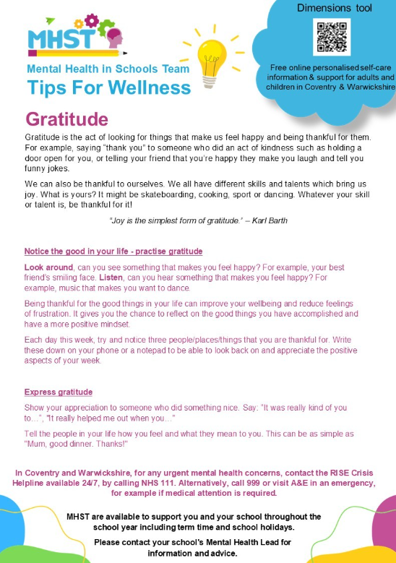

Slide 7


