Slide 1






St John Vianney Catholic Primary
WEEKLY SCHOOL NEWSLETTER – Friday 18th September 2026
Dear parents,
“Lord Jesus, teach me to be generous – to give and not to count the cost.”
St Ignatius (Prayer for Generosity)
This Sunday’s Gospel can remind us how God has important work for each one of us, helping to make the world a better place, building God’s kingdom.
We are also reminded of God’s generosity. God loves us and is more generous than we could ever imagine – wanting to take care of all our needs.
Future Dates
29th Sept – Y2 Maths Workshop – 9am
1st Oct – Y1 Inspire Workshop – 9am
2nd Oct – Harvest Mass – 9am
3rd Oct – Y6 Commitment Mass/ R Welcome Mass
Our Mission This Week
.
St John Vianney Catholic Primary School
Mount Nod Way
Coventry
CV5 7GX
Sjv_admin@hccmac.co.uk
Twitter: @sjohnvianney
Phone 02476 464088
Website: www.sjv.hccmac.co.uk

Slide 2



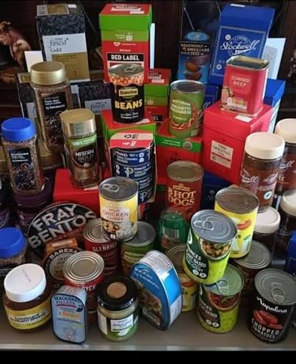
Years 3, 4 and 5 have all had visits to Allesley Library and the librarians have reported back about their exemplary behaviour and enjoyment of the books.
We hope that the children will continue to use the library and borrow books to extend their love of learning
Thank you to all the parents that joined us this week for Year 5 Inspire workshop on creation. We learnt about God’s creation and made clay animals.
On Monday 14th September we celebrated the Holy Cross Feast Day and St John Vianney’s feast day (although that is usually 4th August, but we are never in school). The children learnt about the importance of our patron Saint and the love that is embodied in the Cross of Jesus.
Next week
21st September - Year 6 Library visit
We are having a visit from Father Hudson Caritas
23rd September – Year 6 Reading Café
24th September Bishop Ullathorne Open Evening
25th September Non uniform Day – Donations of Food
25th September - Reception Welcome assembly

Slide 3



Well done to the Stars of the week
Nursery | Whole Class
Reception | Sammy & Charlotte
Year 1 | Ivy & Theo
Year 2 | Bobby & Robyn H
Year 3 | Joshua & Thea
Year 4 | Izzy & Oliver
Year 5 | Xayne & Katie
Year 6 | Anais & Ambroz
Sports | Emily Y2 & Caolan Y5
Attendance SJV
EYFS and KS1 |  | KS2
Class Name | Weekly Attendance | Class Name | Weekly Attendance
Nursery | 91.96% | Year 3 | 100%
Reception | 93.70% | Year 4 | 95.19%
Year 1 | 97.78% | Year 5 | 97.49%
Year 2 | 98.15% | Year 6 | 98.89%

Slide 4
St John Vianney Catholic Primary
WEEKLY DIARY
Date’s may be subject to change – please check your emails regularly
Monday 21st September 2026
Choir – KS2 – Lunchtime
Year 6 Library Visit – 1.30pm
Dance – KS2 – 3.15pm-4.00pm
Netball Training – Yr 5 & 6 – 3.15pm-4.15pm
Tuesday 22nd September 2026
Reception Music – Lunchtime
Recorder Club KS2 – 3.15-4.00 pm
Boys Football Training – 3.15 – 4.15 pm
Wednesday 23rd September 2026
Running Club Key Stage 2 – 8.00 – 8.30 am
Year 6 Reading Cafe – 8.45 am
Guitar Tuition
Flag Football KS2- Lunchtime
Dance Year 1 and 2 – 3.15-4.00 pm
Girls Football Training – 3.15 -4.15 pm
Thursday 24th September 2026
Mini-Tennis - Year 5 & 6 - 7.45 to 8.30 am
Piano Tuition
Creative Flair Dance Year 1 - 4 – Lunchtime
Cricket – 3.15-4.15pm
Bishop Ullathorne Open Evening – 5 – 7pm
Friday 25th September 2026
Reception Welcome Assembly – 9am
Flag Football KS1 – Lunchtime
Non-Uniform Day

Slide 5


Slide 6


Slide 7


